Slide 1
MR ENTEROGRAPHY
HOW I DO IT ?
C.Hoeffel
CHU Reims

Slide 2
MR Enterography- How?
Clear guidelines based upon ESGAR expert consensus committee chaired - 10 members for adult + 3 for peds
Statements were scored for agreement by the panel
  82 % achieved immediate consensus
  12 % achieved consensus after appropriate modifications
  6 % were rejected as consensus could not be reached
Notes:
This talk will not adress the issue of MR enteroclysis although few specific recommandations
NJ 8-10 F

Slide 3
Patient Preparation-General
Little evidence on optimal patient preparation- recommandations based on expert opinion
Routine medications should not be stopped
Patients should not eat any solid food for 4-6 hours nor drink any fluid apart from non sparkling water
No laxative bowel prep
No rectal water enema
Although good evidence that
detection of colonic inflammation is improved
So unless dedicated exam needed
Notes:
LITTLE EVIDENCE ON OPTIMAL PATIENT PREPARATION PRIOR TO mri OR ct? AND RECOMMANDATIONS WITH REGARD TO PERIODS OF NIL BY MOUTH FOR SOLID OR FLUIDS ARE BASED ON EXPER OPINION
Rectyal enema and bowel laxation not recommended although there is good evidence that detection of colonic inflammation is improved with admin of a water enema in comparison to evaluating the unprepared colon
If dedicated colonic evaluation is required it is therfore recommended to prepare the colon using a water enema or with prolonged oral prep
INGESTION OF SPARKLING WATER IS NOT RECOMMENDED DUE TO THE RISK OF PRODUCING INTRALULMINAL GAS ARTEFACTS

Slide 4
Basic Technique- MRE
No single preferred contrast agent for MRE (or CTE)
Recommended agents: hyperosmolar properties
  Mannitol
  PEG
  Sorbitol
  Lactulose, etc..
Optimal volume of oral contrast: 1000 -1500 ml- 20 to 25 ml/kg in peds- split in two aligots or continuous?
Notes:
NO EVIDENCE FOR SUPERIORITY OF ONE ORAL CONTRAST AGENT OVER ANOTHER
One study showed on 10 volunteers that distension quality is inferior when the ingested volume of oral contrast is below 1000 ml
No consensus as to whether the oral contrast should be split into two aliqots priot to ingestion or drunk continuously and both approaches seem acceptable
No consensus on th eminimum quantity of oral contrast agent

Slide 5
Basic Technique- MRE
What should be the ingestion time of oral contrast in a patient without previous major small bowel resection ?
  40-60 minutes
What do I do when there is a stoma?
  Plugg it
Scanning earlier may be advisable (30 minutes) in patients with significant bowel resection
What if I perform MR enterography to evaluate colon?
  Administer liquid enema based on patient tolerance or prolonged oral contrast prep and use water to distend the bowel

Slide 6
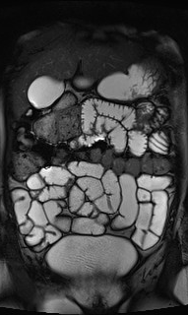
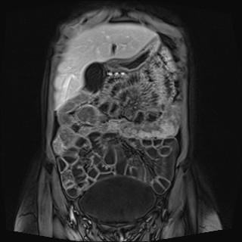
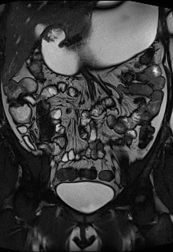

Slide 7
Positioning
Patients can be scanned prone or supine
Prone position
  Pro
    Less slices because of abdominal compression thus reducing hold breath
  Con
    Not comfortable

Slide 8
Sequences and Technical considerations
Is MR Enterography feasible at 3 T?
  Yes, both 1.5 and 3 T are adequate
Use of phased array coils is mandatory
Spasmolytic agents: are they useful?
  Yes, they are recommended- how and when?
  Before gado ± diffusion
  First line: IV hyoscine butylbromide 20 mg (0.5 mg/kg in peds)
  Second line: IV Glucagon (0.5 mg if < 25 kg and 1 mg if > 25 kg)
  Optional in peds
Fiorino G, et al. Dig Dis Sci 2013
Jiang X, et al. Int J Colorectal Dis 2014
Notes:
There was no consensus as to which field strenght was optimal for enteric MRI with data suggesting high image quality is routinely possible on 3 T as well as 1.5 T
Bost antispasmolytic agents efficient although no evidence. Expert opinion for first line hoscyine butylbromide
Optimal timing of administration or whether the dose should be split in an attempt to maintain persitalsis throughout duration of MR examination recommended taht spasmolytics should be adminestered before motion sensitive sequences as either a single or split dose

Slide 9
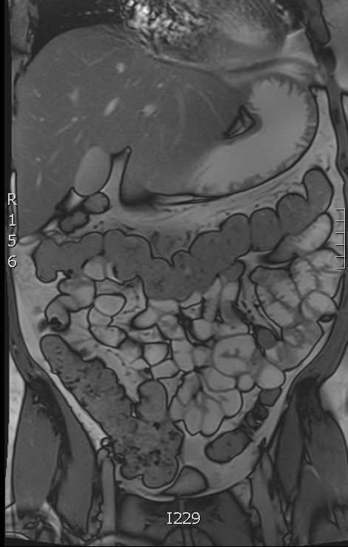
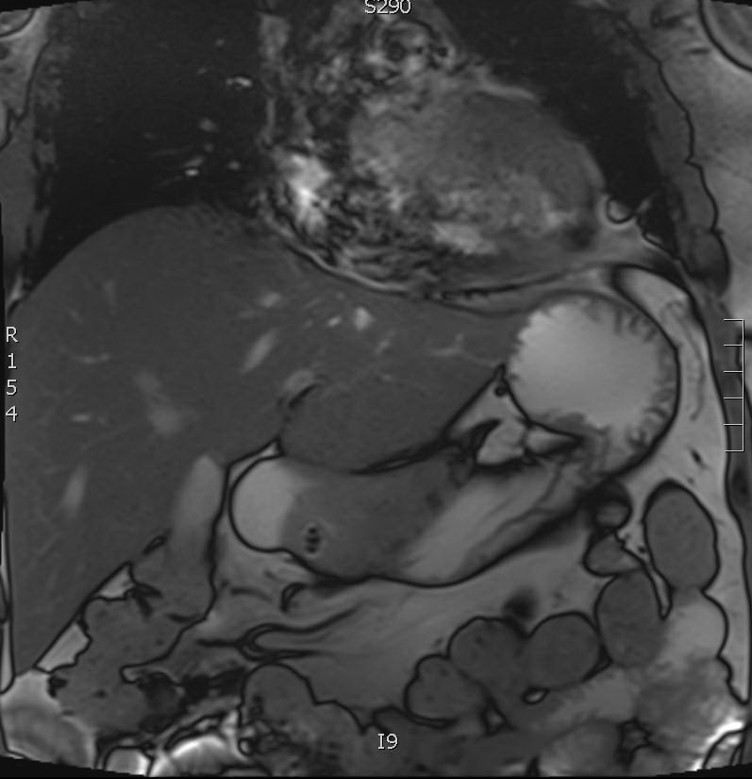
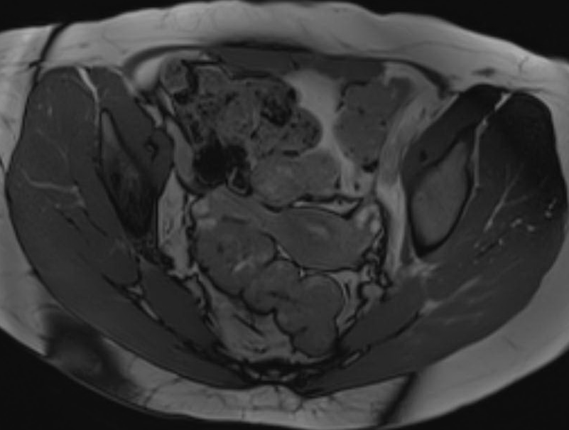

Slide 10
Sequences and Technical considerations
What basic sequences should the protocol be including?
  Axial and coronal fat spin echo T2 W sequences without fat saturation
  Axial and coronal steady state free precession gradient echo ( SSFP GE, TRUFFI Siemens) without FS
  An axial or coronal Fat saturated FSE T2W
  Maximal thickness 5 mm, 2D or 3D but 2 D is preferred
Notes:
No evidence informing the optimal combination of T2 and SSFP ge SEQUENCES ALTHOUGH NEARLY ALL STUDIES IN THE LITERATURE UTILISE BOTH SEQUENCES TYPE

Slide 11
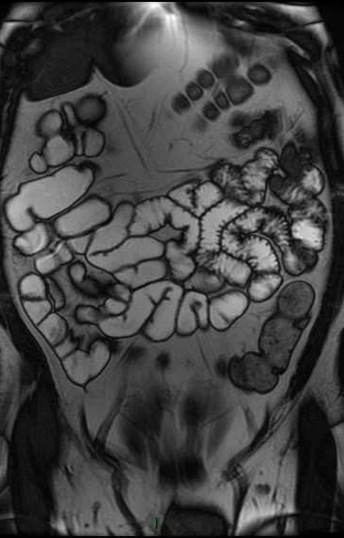
TRUFI /FFE/FIESTA- balanced steady-state free procession
Pros=
  Fast, lack of motion artefacts.
  Mixed T1 and T2-weighted contrast with signal of fluids very high and signal from soft tissues T1 like
  No need for breath hold
  Detects small bowel thickening and extramural findings
  Mesenteric vessels and lymph nodes well identified
  +/- dynamic sequences: motility studies (decreased motility in inflamed bowel- differentiation between fibrotic and inflammatory involvement)
Cons=
  No information on disease activity (edema or fibrosis)
  Susceptibility artefacts and mild chemical shift effect
Notes:
Fats imaging employing steady-state acquisition or fast imaging with steady state precession or balanced fast field echo are characterizd by very short acquiistion times and lack of motion artefacts
The cine true fisp sequence involves repeatedly imaging of the abdomen. Inflamed loops will demonstrate decreased peristalsis. An inflammatory SB stenosis should open up on cine imaging compared with a fibrotic stricture where the stenosis will be constant and associated with more marked pre stenotic dilatation.

Slide 12
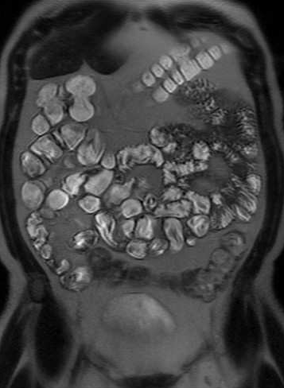
T2 HASTE/RARE/ single-shot half-Fourier
Pros =
  High temporal resolution and a satisfactory spatial and contrast resolution
  Lack of motion artefacts
  Either breath hold or breath-hold free acquisition- very short
  Used for oedema. Optional use of fat sat on one of the T2 weighted sequences for differentiation between submucosal fat and oedema.
Cons =
  Flow-void artefacts due to intestinal peristalsis
  Mesentery ±marked brightness of mesenteric fat that can impair detection of nodes
Notes:
Characterized by very short acquisition times (less than a second per image) based on the use of multiple refocusing 180 ° pulses, in order to generate multiple echoes (echo train) after the initial excitation.
they are charcaterized by marked brightness of the mesenteric fat that can impair the detection of mesenteric of mesenetric inflamed lymph nodes and fluid collectionss, which may appear as hyperintense as the fat tissue.fat suppression may be helpful in these cases
Selective suppression of fat signal on T2-weighted imaging also helps detecting mesenteric inflammation distinguishing normal bowel loops from fluid collections phlegmons and abscesses and identifying mesenteric-inflaùmed lymph nodes
Usually both mural and extramural findings are detectable on T2-weighetd images with the same accuracy than gadolinium ones

Slide 13
Sequences and Technical considerations
FS Non- enhanced coronal T1 followed by Gado
  If IBD, Enteric (45 sec) or portal venous (70 sec) phase
  If suspected chronic GI bleeding , arterial (30 sec), enteric (45 sec) and portal (70 sec)
  Pump-injected with infusion rate of 2 ml/sec and 0.1-0.2 mmol/kg in adults and peds (0.1 )
  Maximal slice thickness 3 mm, 3 D
  Coronal and axial
  Utility in validated scores and proven increased accuracy
Maccioni Radiology 2006
Makanyanga JC Eur Radiol 2014
Notes:
Proven increased diagnostic accuracy with us eof gado sequences
And utilidty of bowel enhancement in validated scores

Slide 14
3 D T1 GE Fatsat without and after gadolinium
Axial 2 D gadolinium-enhanced FS T1 EG
Wall ++
Mesenteric analysis
Motion artefacts

Slide 15
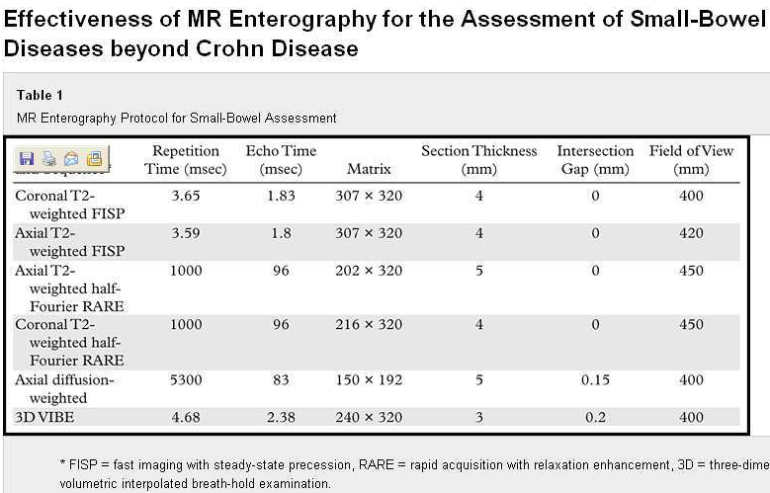
Amzallag et al. Radiographics 2012
Notes:
Most of T2-weighted sequences may be acquired either during a single 20-22 sec breath hold, which generates 25-30 adjacnet images on axial and coronal planes or in breath hold free acquisition
Widely used T2-weighted sequences for CD are fast spin echo and balanced ones with or without fat saturation

Slide 16
Sequences and Technical considerations
What are the Optional sequences?
  Additional fat-suppressed FSE T2 W in another plane
  Axial and coronal SSFP sequence with fat suppression
  Cine motility
  Diffusion-weighted imaging
    Free-breathing
    0-50 to 600-900
    5 mm max
    Axial but coronal not recommended
  Dynamic CE may provide additional information in the form of quantitative measurements of CE
Notes:
Cine motility= increasing evidence in support of quantified small bowel motility to improve dic accuray and disease activity
Idem for DWI even potential replacement for iv CONTRAST ENHANCED SEQUENCES BUT NOT YET FULLY ESTABLISHED
PARticularly useful in peds

Slide 17
PEG
Truffi
Haste
DWI
GE T1 Gado FS
Glucagon 1 mg to
reduce bowel peristalsis

Slide 18
Sequences and Technical considerations
Scan coverage and Duration
  Should include at least small bowel and colon extended to the pelvis
    Perineum?
  From back to front, cover only what is necessary not to increase breathhold duration.
  Total acquisition time ≤ 30 min

Slide 19
Indications
Crohn’s disease
Tumors
Other small bowel conditions, as an alternative to CT or to endoscopic techniques
Amzallag-Bellenger E. Radiographics 2012 and Eur Radiol 2012 et 2013

Slide 20
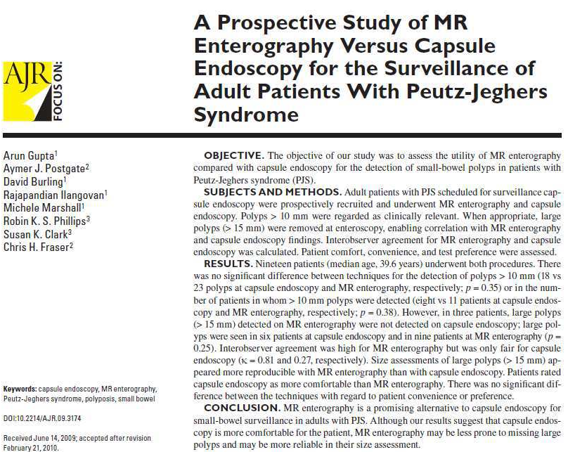
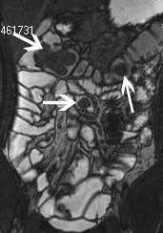
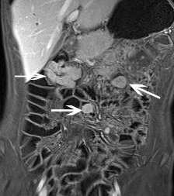
Notes:
Peutz jeghers
Autosomic dominant
Association between lentiginosis and small bowel polyposis
Very high risk of cancer 93 % between 15 and 643 years of age. Mean age 43 years
Cancer occurrence: lung testis breast ovary
Tap every two years or vce
Localisation of the biggest polyps
Radiation-free
BUT no differntial diagnosis between adenomatous polyps and hamartomas
No complete analysis of the number of polyps
Whole body analysis impossible in order to visualize otyher cancer localisations
Polypectomy of any polyp > 10 mm because risk of intussusecption and/or ulcer and absence of a possible differential diagnosis between adenoma and hamartoma
Imaging must look for other location

Slide 21
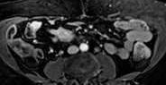
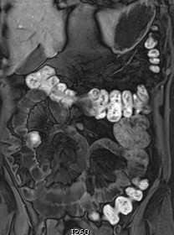

Slide 22
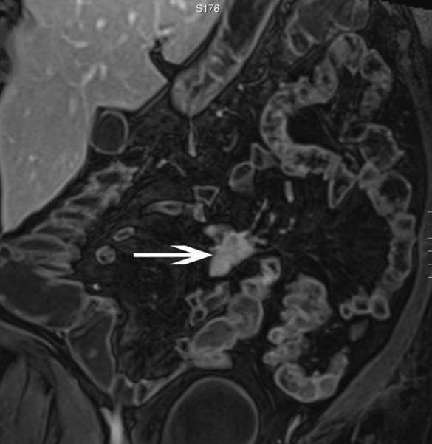
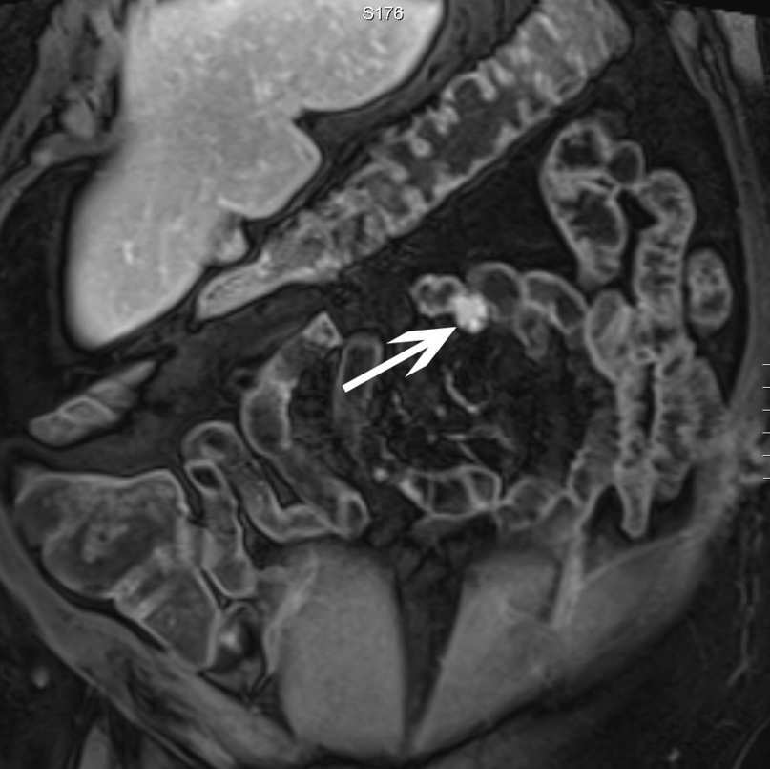
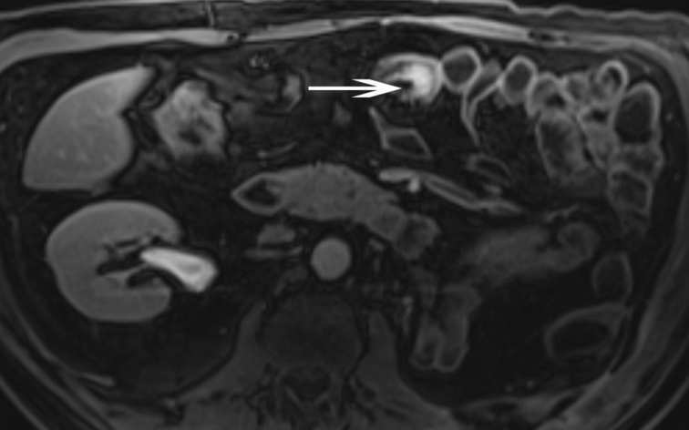

Slide 23
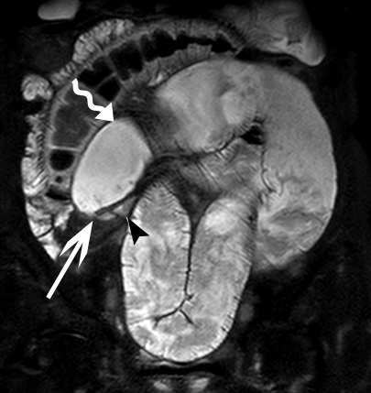
Amzallag-Bellenger et al.
Radiographics 2012

Slide 24
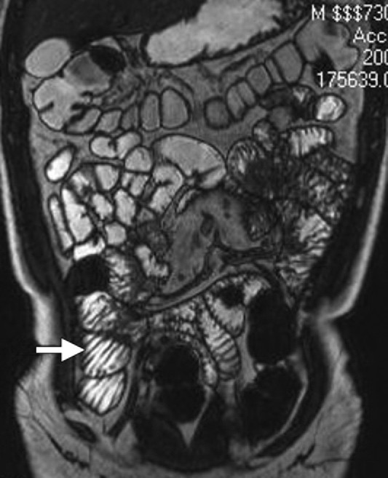
Diagnosis made with biopsies
Imaging for patient non responding to gluten-free regimen
Look for lymphadenopathy and size of spleen (prognostic factor)

Slide 25
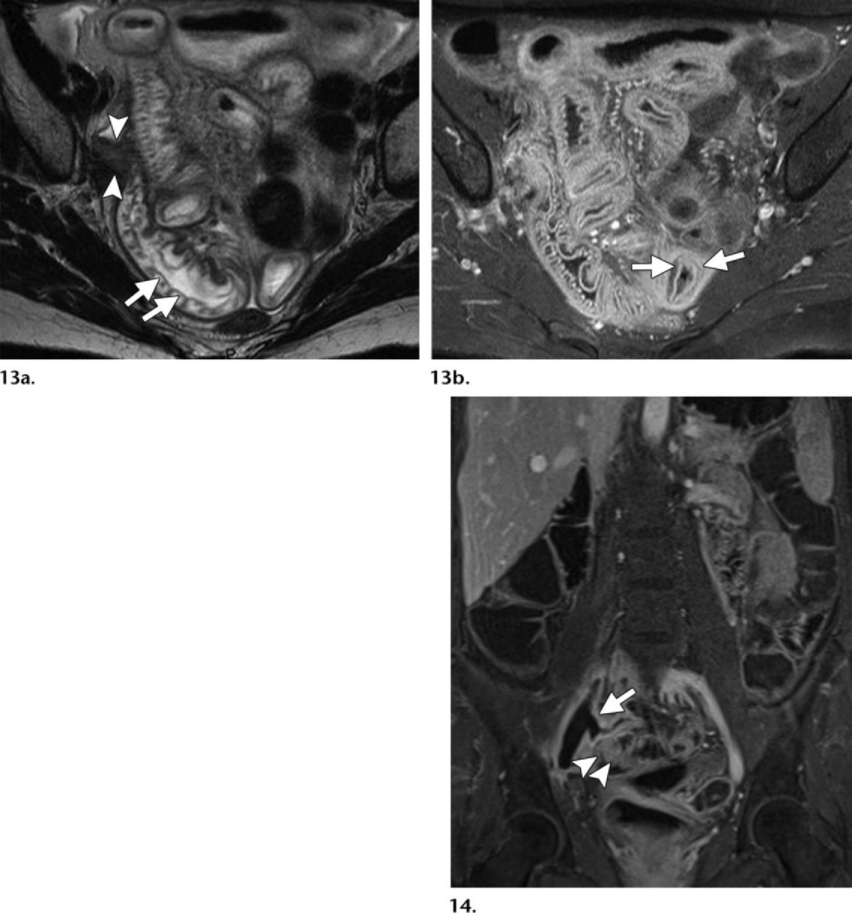

Slide 26
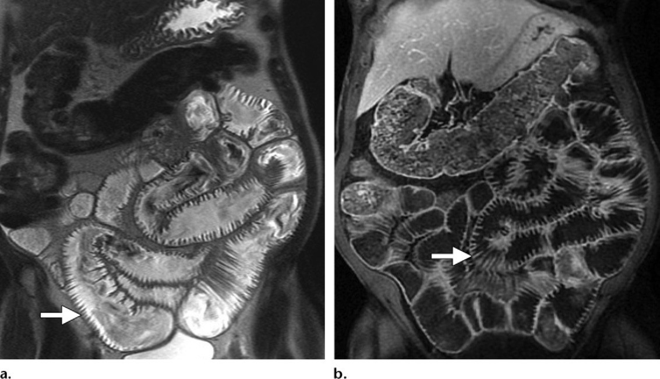

Slide 27
MR ENTEROGRAPHY FOR CROHN ‘S DISEASE
HOW I REPORT ?
C.Hoeffel
CHU Reims

Slide 28
Why Enterography?
Enteroclysis or Enterography?
  Few studies comparing both
  Tendency to obtain better small bowel distension with MR enteroclysis but does not demonstrate unquestionably better performance
  MR enteroclysis difficult to repeat-stressful- patients often present for SB imaging with a low pre test probability
Negaard A Eur Radiol 2007
Masselli G Eur Raadiol 2008

Slide 29
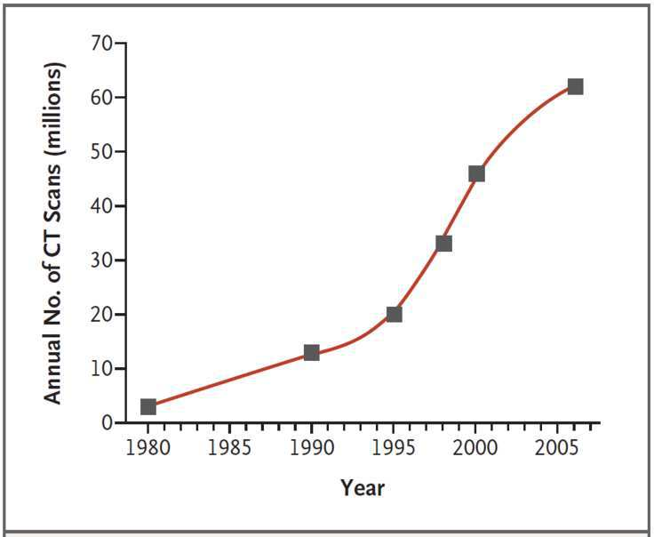
Why MR-enterography in CD ?
Both CT and MRI accurate
  Exposure of patients to ionizing radiation= important concern
  MRI allows repeated dynamic imaging.
Brenner DJ, et al. N Engl J Med 2007;357:2277-84.
Notes:
Superficial leisons cannot accurately be visualized so CT should thus not be used as a first line examination when mild disease is suspected. Horsthuis K ABDOM IMAGING 2008
An area of intermittent spasm or peristaltic contraction occurring during the CT examination may be misdiagnosed as a small bowel lesion
The initial use of CT is to be preferred in elderly patients because MRI is more time-consuming and the image quality provided by MRI varies to a greater extent than that of CT
Ct DETECTS perforation more accurately and rapidly than MRI and it also rules out clinically unsuspected pathology outside the bowel wall that may cause acute abdomen.
Better than MRI in the assessment of potential perforation or complete bowel obstruction to help direct therapy in the emergency room

Slide 30
Diagnostic accuracy of MR imaging
No significant differences for CD location, extent
MR
  Se/Sp for diagnosis of CD 78 and 85 %
  Se/Sp for assessment of disease activity 80 and 82 %.
  In elderly patients and in emergency setting prefer CT (perforation)
Fiorino G. IBD 2011
Panes G APT 2011
Rimola J IBD 2011

Slide 31
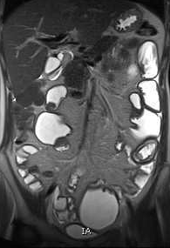
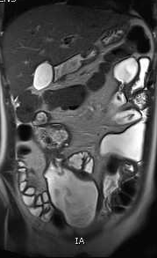
Patchy inflammation/ Entire gastrointestinal tract
All layers of GI wall
Extra-intestinal manifestations
Risk of cancer
Notes:
CD is characterized by a transmural, patchy granulomatous inflammation that may occur in any part of the GI tract, although it is more common in the ileocecal area. The course of the disease is usually remitting-intermittent and falres are charcaterized by clinical symptoms that may or may not be associated with either humoal and/or visual evidence of active inflammation.

Slide 32
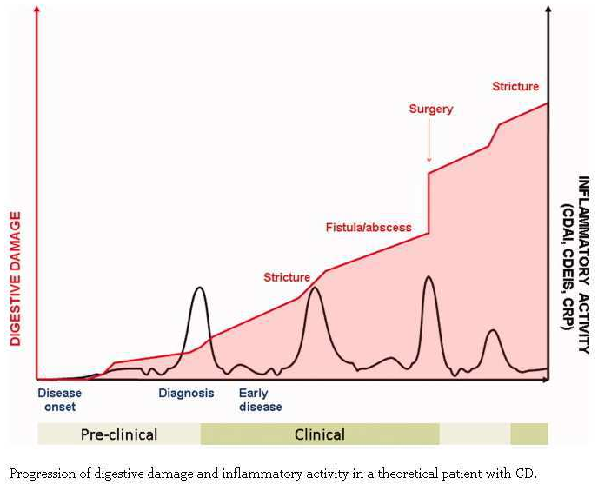
Discrepancy between clinical activity and damage progression => Role of imaging. Almost 1 p/2 need to be operated 10 years after diagnosis
Pariente B et al. Inflamatory bowel disease 2011
Notes:
New imaging techniques have increased the accuracy in defining changes in bowel structure and they can quantify damage, measure progression disease over time and assess the impact of threatment strategies in the progression of CD.
Commence en général comme une inflammation qui est latente cliniquement ou subclinique puis devient spique puis donne des complications avec chir repetees et un risque de mort accru
Cascade d’événements dont la séquence varie; plus le malade est jeune au début de la maladie plus vraissemblablemnet il aura une maladie évolutive
Comme il y a une discordance entre l activité clinique et la progression des lésion, la radiologie est importante. Parfois cela prend du temps, des années avant que la spie se manifeste. L ideal serait que le traitement soit mis en place pdt cette phase presymptomatique mais malheureusement le diagnostic est souvent tardif
En dépit des traitements presque la moitié des patients ont besoin d être opérés dans les dix ans qui suivent le diagnostic
En fait cela ne régresse pas pendant les phases de présentation asymptomatique
La chir ne traite que les complictaions

Slide 33
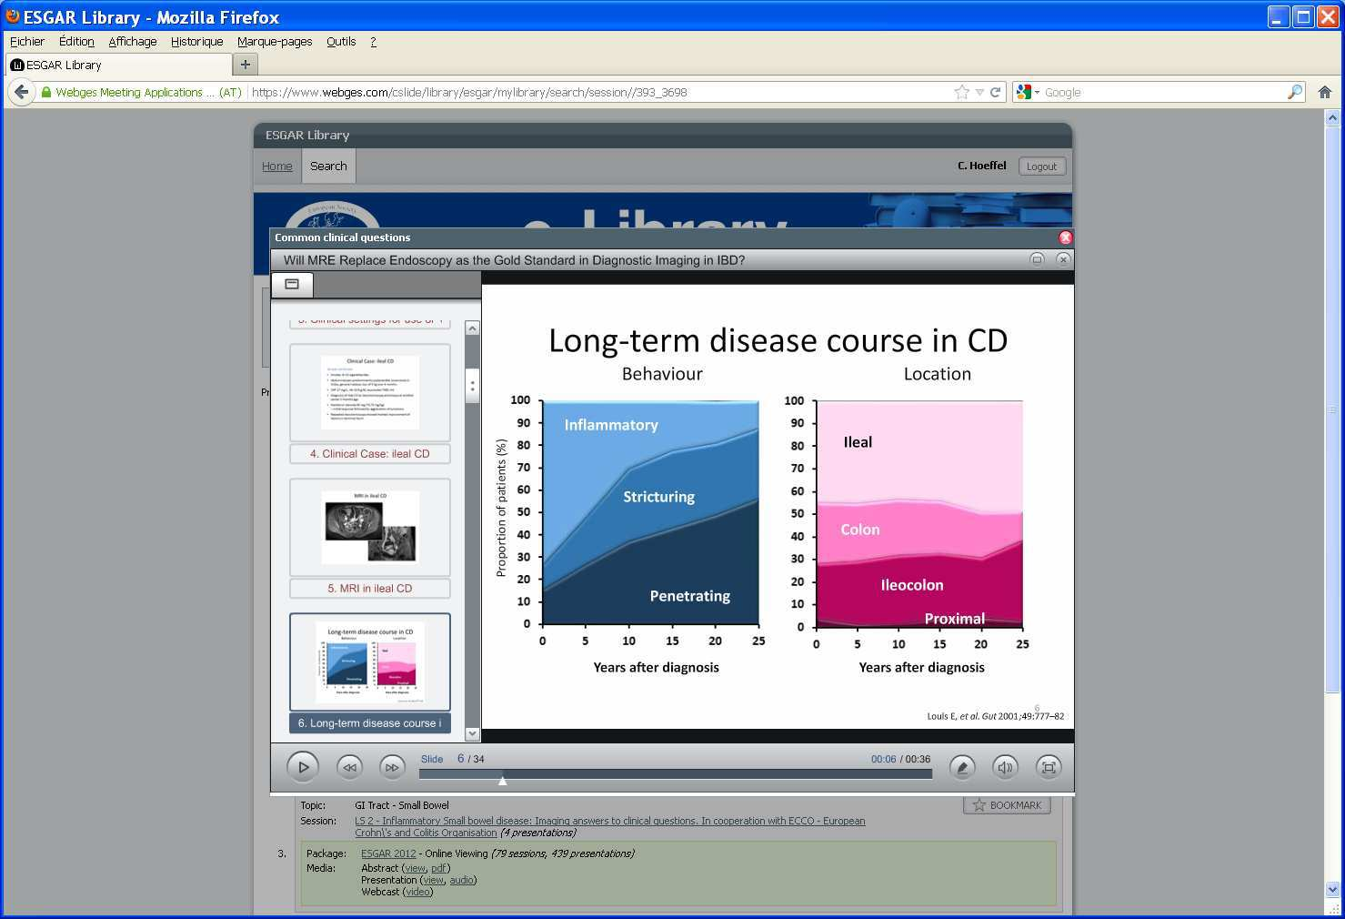
Long-Term disease course in CD
Vienna Classification
  B1: Purely inflammatory
  B2: Fibrostenotic
  B3: Penetrating
16 % only will change location after 10 years
Louis E . Gut 2001; 49: 777-82.
Notes:
Vienna Classification
B1: Purely inflammatory
B2: Fibrostenotic
B3: Penetrating
Most patients have a B1 phenotype at diagnosis but progress to B2 and B3 over time, leading to irreversible damage.
Although the course of the disease is unpredictable, three main CD courses or phenotypes have been identified: fistulizing, fibrostenotic and inflammatory according to the vienna classification. The majority of patients has an inflammatory phenotype at the time of the diagnosis whilst at long term fup as many as 88 % will develop either fibrostenosing phenotype and the ebvolution typically occurs within 10 years from the initial diagnosis
La localisation de la maladie reste stable durant l evolution de la maladie
maladie de crohn iléale était plus souvent sténosante v et la maladie de CD iléocolique plus souvent transfixiante, à l afois au diagnosyic et cela devenait proéminent apres 10 ans

Slide 34
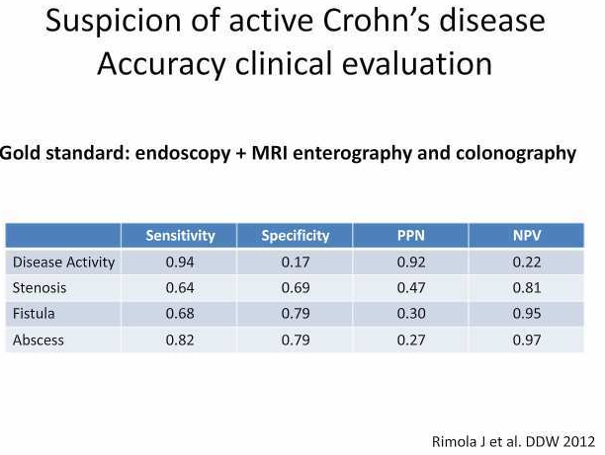
Clinical assessment
Time-consuming and cumbersome
Patients with chronic but relatively inactive disease are often scored high
Cannot provide information about specific disease sites in patients with multifocal disease of differing activity.
100 patients reviewed =>
Notes:
100 patients repris, bien catégorisés et diagnostiqués par endoscopie et irm (<48 h). Apres un an medical records étudiés, 4 cliniciens ont évalué l activité de la maladie etc.. Pas bon pour les sténosse ni pour les abces pour les abces mieux mais echec ds 20 % des cas d ou la nécessité d’avoir des mesures de l’activité et des complications

Slide 35
Role of Cross-sectional imaging
Limitations of ileocolonoscopy
  Sometimes incomplete
  Limited in patients with upper lesions or fibrostricturing disease
Additional information
  Proximal ileal disease with skipping of terminal ileum
  Penetrating disease with overlying normal mucosa
  Beyond Stenosis and around the bowel
  Extraintestinal manifestations: PSC, sacroileitis etc..
=> Change in management in around 50 %
Siddiki HA et al. AJR 2009, Bruining DH et al. IBD 2008, Higgins P et al. IBD 2007

Slide 36
Goals of Imaging
Detect disease and differentiation from other SB diseases
  In case of acute symptoms or in case of doubt between UC and CD with negative biopsies. Capsule endoscopy if still negative
Initial work-up:
  Classify location and phenotype of disease. Extent (number, length) of disease
Assessment of complications and surveillance of treatment (Inflammatory activity: mild, moderate, or severe)
Follow-up if clinical or biological change
Postsurgical evaluation
Van Assche et al. , European Crohn’s and Colitis Organisation (ECCO) (2010) The second European evidence-based Consensus on the diagnosis and management of Crohn’s disease:
Definitions and diagnosis. J Crohns Colitis 4:7–27
Notes:
Estimer la progression des patients sur une base individuelle
Avec une cartographie ils vont ou sont les lésions car la localisation est constante, les lésions sont toujours au même endroit donc plus facile pour le suivi avec un mapping précis
ECCO statement 2 F
For suspected CD ileocolonoscopy and biopsies from the terminal ileum as well as each colonic segmeent to look for microscopic evidence of CD are first line procedures to establish the diagnosis
Irrespective of the findings at ileocolonosocpy further invetsigation is recommended to examine the location and extent of any CD in the upper gastrointestinal tract or SB

Slide 37
MR Analysis
Endoluminal
Small Bowel
Outside Bowel
  Ulcerations
  Thickening
  Enhancement
  Edema
  Fibrosis
  Stenosis
  Fistulas
  Abscess
  Sclerolipomatosis
  Fistulas
  Fluid
  Hyperhemia

Slide 38
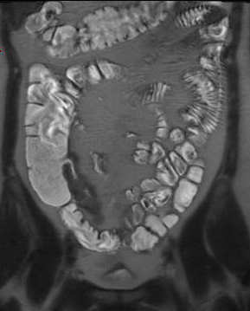
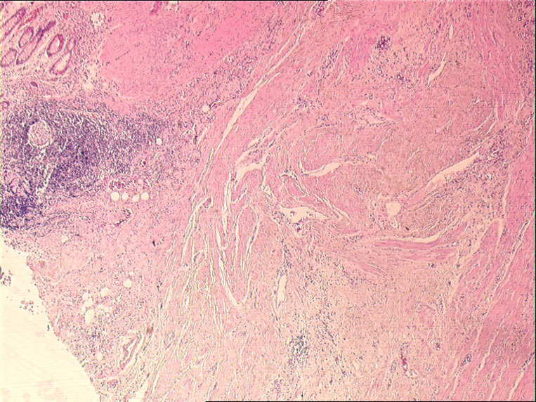
Bowel wall thickening
T2 HASTE= significant if > 3 mm

Slide 39
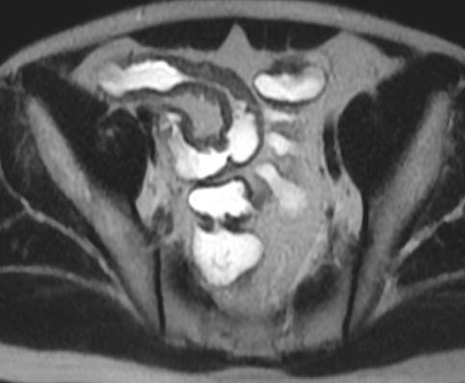
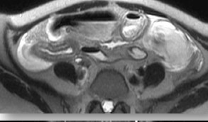
T 2 signal
Sign of activity and severity
Development of fibrosis determines
a reduction of the mural T2 signal in active disease
whereas it does not usually affect the wall enhancement
Evaluation relative to signal of muscle or of normal wall
Notes:
The development of fibrosis invariably determines a reduction of the mural T2 signal in active disease, while it does not ussually affect the wall enhancement according to maccioni’s experience, a layered gd enhancement of the wall frequently persists in chronic fibrotic diseases while the T2 signal of the wall progressively decreases

Slide 40
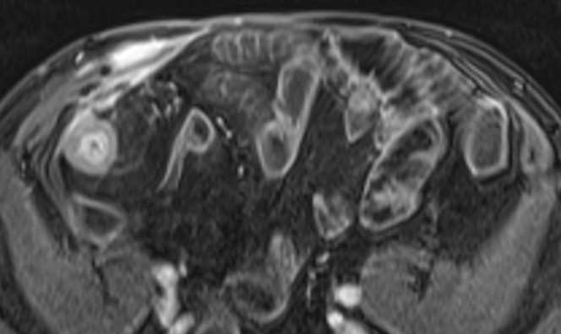
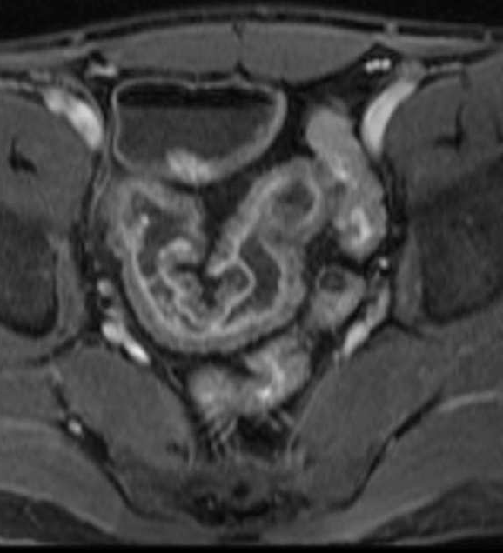
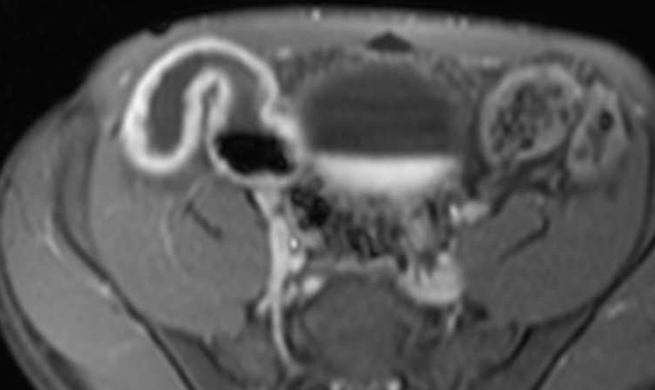
Bowel wall enhancement
- Either qualitative or quantitative
Notes:
40
Homogeneity of B1 field, i.e radiofrequency pulse is crucial for producing uniform signal across the image. B1 field is not uniform and the portions of the body that are closest to the phased array elements experience a higher B1 field than central areas of the body. This often results in bowel segments located peripherally apparently demonstrating higher signal than those located further away from the coil. Susceptibility gradients, reduction in b0 field homogeneity at the exteremes of the imaging volume, respiratory artefacts partial volume effect and chemical shiuft effect can all further degrade image quality
Little data on the levels of intra and inter observer agreemnet when grading bowel wall enhancement qualitatively

Slide 41
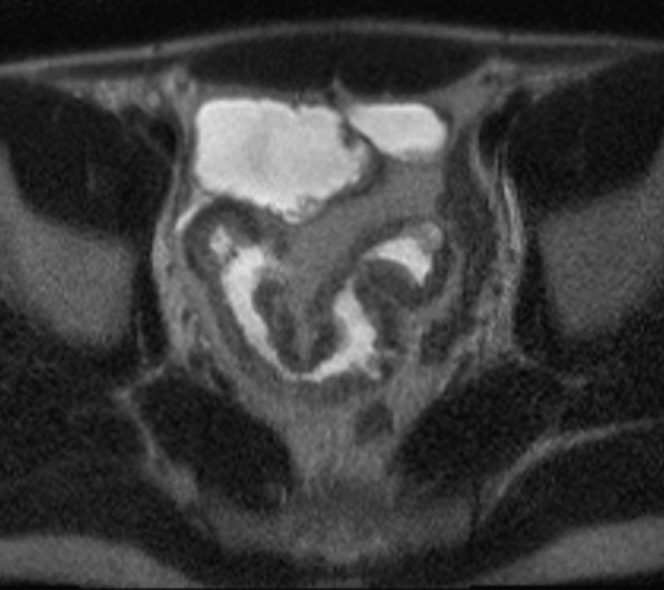
Ulcerations

Slide 42
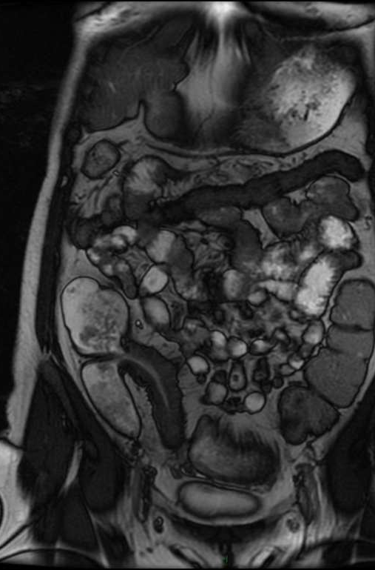
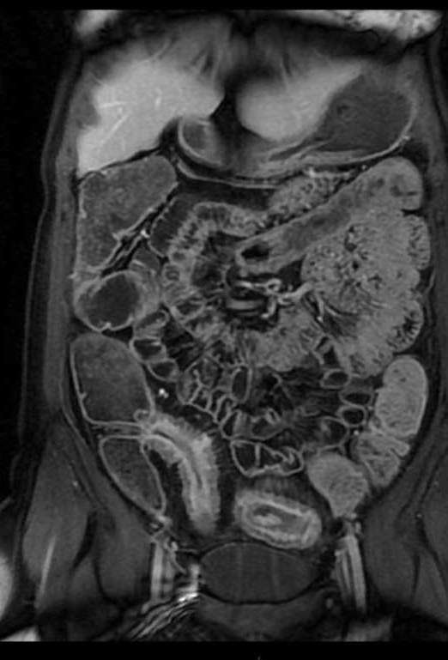
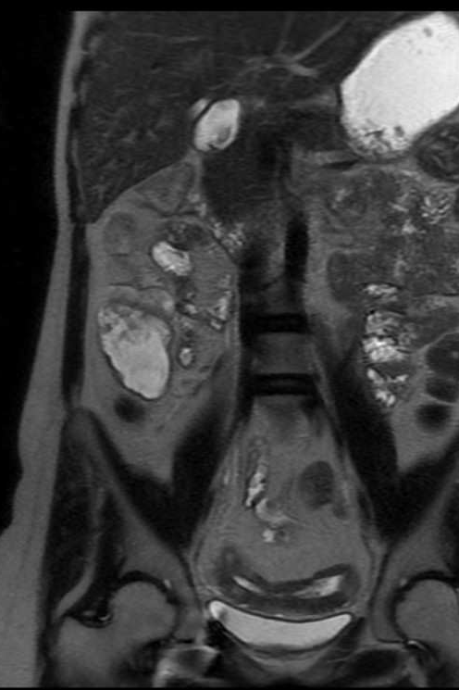
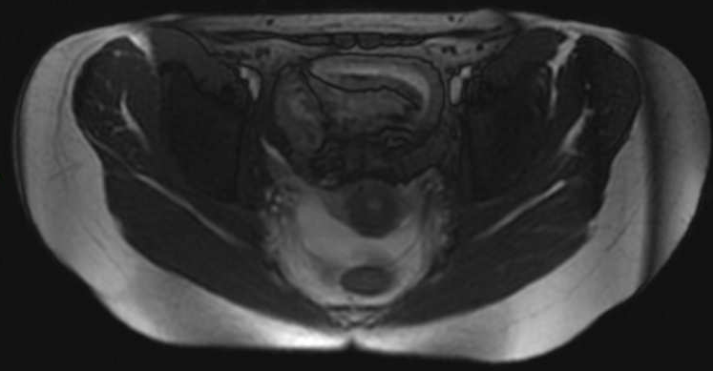
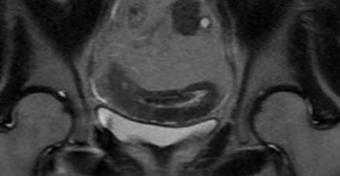

Slide 43
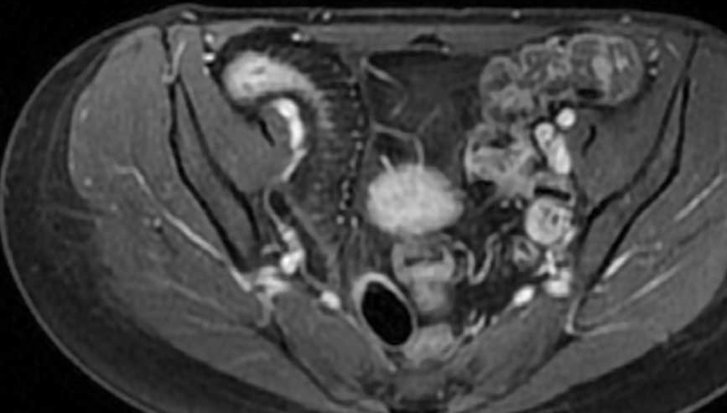
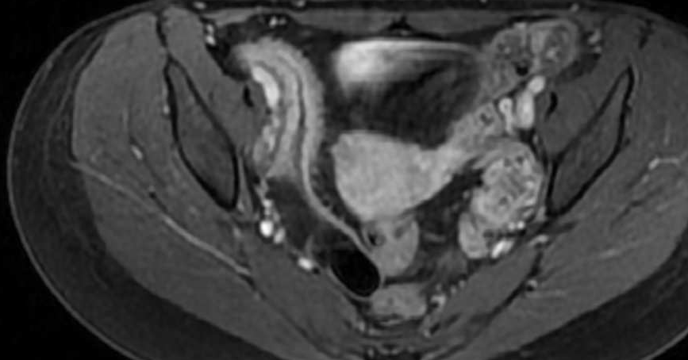
Comb sign
Mesenteric hypervascularization =enlargement of mesenteric vessels

Slide 44
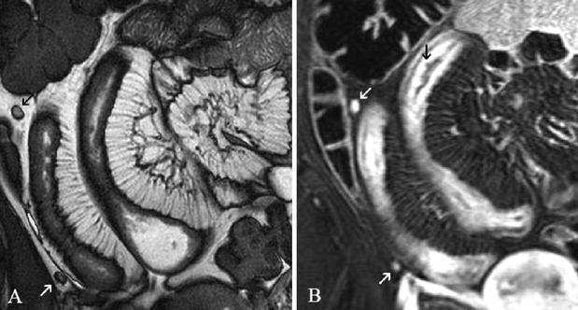

Slide 45
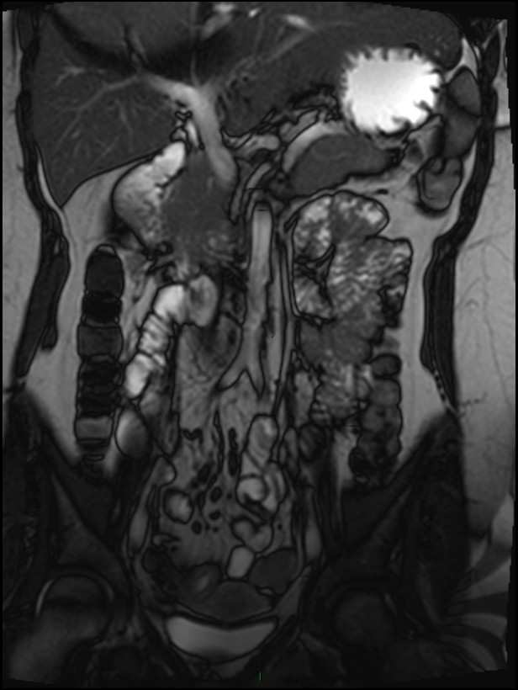
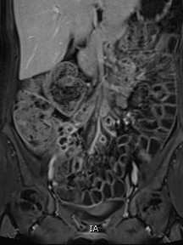
Lymph nodes

Slide 46
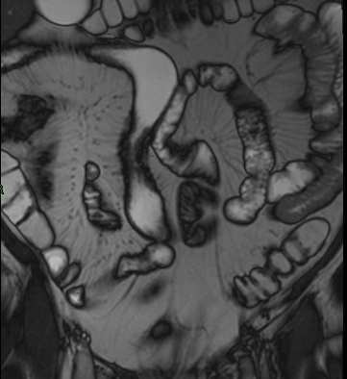
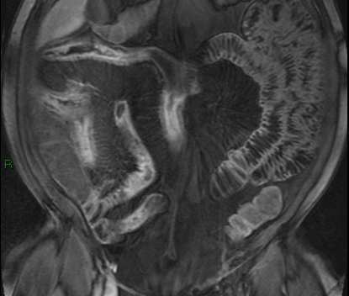
Sclerolipomatosis
Notes:
46
46

Slide 47
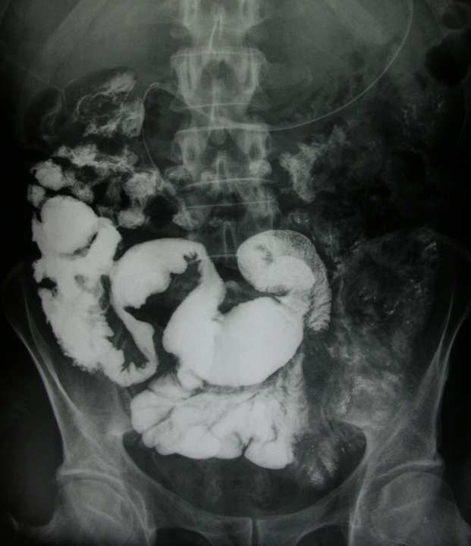
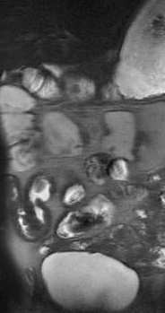
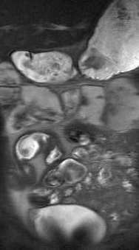

Location and Length of disease
Haste

Slide 48




Slide 49



Slide 50
Complications
Fistula
Inflammatory mass
Abscess
Stenosis and obstruction

Slide 51

Notes:
Surgeon for laparoscopy must precisely know where he is going because must be careful not to touch the bladder for ex

Slide 52

Penetrating form-Fistula

Slide 53


Fistule iléo-caecale

Slide 54






Slide 55


T2
T1

Slide 56






Slide 57



Slide 58




Haste
T1 Gadolinium

Slide 59


Inflammatory Mass
T2
T1
Notes:
Masse inflammatoire = trajets fistuleux fermés sans collection drainable ou avec si pas abces antitnf
Forme inflamm CT + IS
Fistule antitnf + isup sauf si sténose ou abces
Perfo-abces AB, drainage chir

Slide 60


T2
T1

Slide 61




Slide 62
Masse inflammatoire- fistules : iléo-iléale, vésicale

Slide 63


Slide 64





Abscess = CI to infliximab
Notes:
Detection of large-volume abscesses is particularly important, not only because they cause symptoms, but because their presence is a contraindication to therapy with anti–tumor necrosis factor immunomodulators such as infliximab (Remicade; Schering-Plough, Welwyn Garden City, England) (49). In many cases, such abscesses must be treated with imaging-guided drainage before medical therapy is commenced.
Reactive loculated peritoneal fluid is occasionally seen in patients with severe nutritional failure, in patients with long-segment inflammation, or as a normal physiologic finding in young women with Crohn disease. It may mimic abscess, but it will not demonstrate an enhancing wall or adjacent peritoneal thickening, and it will have uniform high signal intensity (Fig 3a).

Slide 65



Slide 66




Abcès

Slide 67

Panès J. Alim Pharmac Therapy 2011
Fiorino G. IBD 2011 MR> CT for detection of strictures (p=0.04)

Slide 68
Definition not consensual BUT Two indirect signs suggestive of stenosis
  Dilatation
  Loss of peristaltism

Slide 69

QUESTION: Fibrotic or Inflammatory?
Is it relevant to make an exclusive distinction?
53 patients
Inflammation score correlated with the fibrosis score (r=0.63, p=0.0001)
No correlation between fibrosis score and enhancement pattern or degree
Panès J. ESGAR 2012
Zappa. IBD 2011
Notes:
It may not be relevant to make an exclusive distinction, as is usually done between inflammatory and fibrotic patients
They did not find any correlation between fibrosis score and mri pattern or degree of enhancement

Slide 70


Stenosis
Predominantly Fibrotic
  Milder thickening
  Short
  Few peri- Bowel wall signs
  Absence of hyperintensity on T2
  Late enhancement
Notes:
Two studies
Zappa 53 patients
Punwani 12 patients
Correlation/donnees histo
Patients tous opérés et importance de la fibrose corrélée à l’importance de l’inflammation
Fibrose et inflammation: tous les patients opérés: fibrose sur pièces opératoires et plus ou moins associée à de l’inflmmation

Slide 71


T2
T1

Slide 72


Senosis with dilatation
Atteinte inflammatoire et sténose

Slide 73


Stenosis without dilatation

Slide 74
Activity in CD
Recently, the goal of achieving improvement of mucosal damage or healing has become a therapeutic outcome
=> scores have been used to adress this issue
Van Assche G. 2010 Curr Drug Targets
Froslie KF. 2007. Gastroenterology

Slide 75
Endoscopic activity assessment
CDEIS: Crohn’s disease endoscopic index of severity or simplified endoscopy score (SES-CD)
  Erythema, swelling, nodularity, strictures, ulcerations
  Correlates poorly with CDAI and biological activity ( C R P measurement)
Postoperative setting: Rutgeerts’ score
Notes:
In the last few years, the goal of achieving improvement of mucosal damage or healing has become a therapuetic outcome, and these endoscopic scores have been used to address this issue.

Slide 76
MRI Scores
MaRIA (Barcelona)
CDAS
Clermont-Ferrand
CDMRIS (Paris)
Most famous= MaRia for ileon and colon but
  Bowel enema was used
  Reference= endoscopy

Slide 77


MRI correlates with endoscopy for severity assessment
35 patients with clinically active and 15 with clinically inactive CD, who underwent both ileocolonoscopy and MRI
MRI predictors of endoscopic index of severity: estimation of activity in each segment using a model with simplified coefficients correlated with CDEIS
  Wall thickening
  Relative Contrast enhancement
  Edema
  Ulcers
Rimola J et al. IBD 2011; 17:1759-68. Rimola J et al. Gut 2009; 58: 1113-20
Notes:
One weakness of using surgical specimen as a standard of re for disease activity is that it potentially introduce bias-patients could be end stage but they did not have any complication in their population because they use early surgery as an effective treatyment foe limited terminal ileal disesae
They again used a histopathological reference for validation, acquired by endoscopic biopsy
Rimola assessed 50 patients with clinically active (n= 35) or inactive (n=15) CD, who underwent ileocolonoscopy and MRI

Slide 78
Bowel wall enhancement
Correlation with disease activity but Inconsistencies related to
  Technical limitations of T1-weighted acquisition protocols and enhancement measurements
  Poor interobserver agreement of ROIs
  Difference in standards of reference for disease activity employed between studies
  Important underlying macro and micro vascular change in CD- Microvessel density and disease chronicity have effects on contrast uptake

Slide 79
Signs of Activity on MRI
  Thickening > 6 mm
  Target enhancement
  High signal intensity of the wall on HASTE
  Ulcers
  Mesenteric hyperhemia with blurred contours of the bowel wall
  Diffusion restriction not on its own

Slide 80
Advanced techniques-Diffusion
Detection of inflammation
Limitations:
  bowell movement and poor jejunal studies
  Long acquisition times: 3 to 4 minutes for diffusion with respiratory triggering
  Reproducibility of ADC samples?
Active wall inflammation in CD determines a restricted diffusion- unclear how it correlates to the degree of wall inflammation and/or fibrosis
Non inferiority of DWI compared to gadolinium for detection of inflammatory lesions of CD
Seo N et al. Radiology 2016
Notes:
Oto acad radiol 2009 etude centrée sur le cadre colique 11 p detection inflammation 95 %
Kiryu 2009 etude centrée sur grele et colon (<31 p) sans préparartion
Detection inflammation 86 % sp 81 %
Limites mvt des anses et étude médiocre du jéjunum
Étude avec trigger respi 3 à 4 min

Slide 81



Post surgical Recurrence
Endoscopic recurrence observed in 70 % at one year
Ileocolonoscopy = gold standard for assessment, recommended within the first year after surgery.
MRE correlates with Rutgeerts score
Stricturoplasty in short stenosis < 3 cm/ileocolonic resection
Sailer Eur Radiol 2008
Koilakou IBD 2010

Slide 82



Résection iléocæcale avec anastomose iléocolique droite

Slide 83
Conclusion
  MRI for map of lesions on the small bowel=> Report on
    Location and length of disease
    Complications
    Activity
  Evolving role with a need for objective criteria to assess severity of disease, treatment response and mucosal healing in Crohn disease

